Slide 1
Observations of 2-D waves in neural simulations
Vincent Baker
Drexel University Department of Physics

Slide 2
Methods
We simulate a 300x300 sheet of neurons on a 100 um grid
The neuron dynamics are modeled using the Izhikevich model, mix of inhibitory and excitatory, neuron dynamics tuned to match observations of cortical neuron types per Izhikevich paper
Neuron connectivity is mostly local, connection probability based on exponential distribution of inter-neuron distance
Action potentials are modeled with a propagation speed and an exponential shape to the synapse dynamics
Uniform random stimulus to all neurons based on Izhikevich paper
Simulations are run for several seconds. Results are recorded as videos showing both firing events and membrane potential over time

Slide 3
Wave observations
We observe wave behavior in our simulation:
https://youtu.be/Is8vbyXliV0
https://youtu.be/P2acTtktP_c
We make several initial observations
Simulations start out with a global fluctuations in activity, then settle into complex spatial patterns that maintain roughly constant average membrane potential across the entire network (figure next slide)
Waves typically annihilate each other upon contact. This leads to winner-take-all behavior, where the network can settle into a spatial attractor where activity is dominated by waves emanating from a small number of locations
Action potential propagation speed changes the nature of the spatiotemporal patterns
https://youtu.be/_kCZfIkVQWw (0.1 m/s propagation speed)
https://youtu.be/82bxnbPUqWw (0.4 m/s propagation speed)
In a network with a single LTS inhibitory neuron in the center, the firing activity will be dominated by waves emanating from the area around the LTS inhibitory neuron

Slide 4
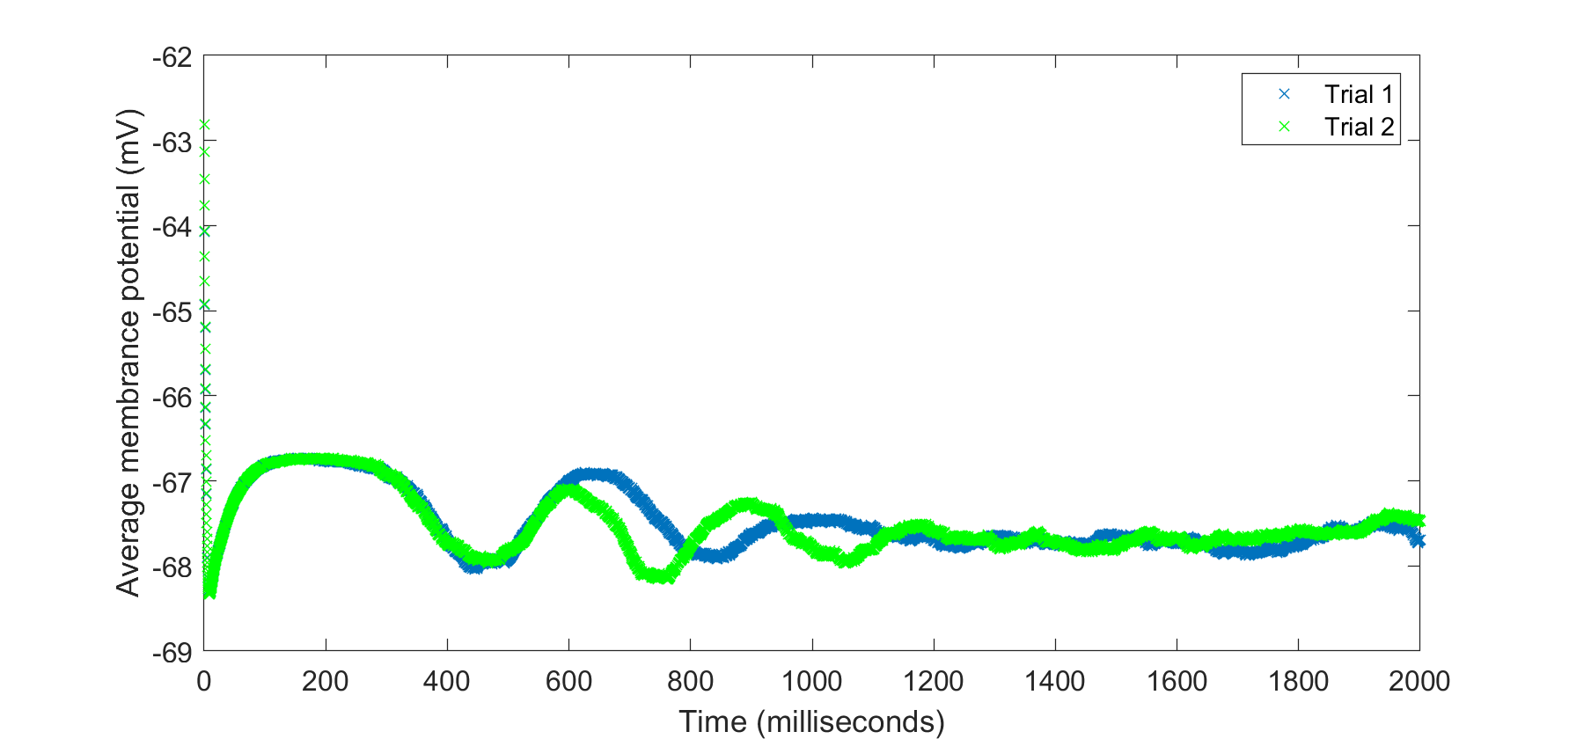
Mean membrane potential

Slide 5
Next steps
Need to develop better wave analysis tools. “Circle matching” didn’t work, these patterns are too complex.
Need to look for correlation between wave initiation sites and regions with a higher density of LTS inhibitory neurons
Need to study the effects of a strong local stimulus on spatiotemporal patterns… does a strong stimulus drive a switch to new attractor state?

